Slide 1
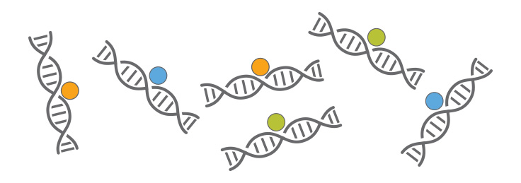
ChIP-seq introduction
Huitian Diao (Yolanda)
References:
ENCODE ChIP-seq pipeline: https://www.encodeproject.org/pipelines/ENCPL138KID/

Slide 2

Using sticky notes for feedback
“I’ve got a good handle on things…”
“I think I understand but I’m still working through things…”
“I’m not understanding and I’m a little lost right now...”

Slide 3
Get course material
Github
Applied-Bioinformatics
Github
HW
git pull
git push
copy
My local:
Applied-Bioinformatics
My local:
My_name_HW

Slide 4
Practice 4.2 (Dump-multiqc)
Tips: Q2.2: Self-help
Google: generate array of number in shell
Google: shell seq output scientific notation
Google: shell convert stdout to array
Q3: Self-help
Google: multiqc documentation
Questions:
Find Run numbers for ChIP-seq data from this paper: B. H., Immunity, 2016 1.1 Search for GEO accession number from paper 1.2 Find SubSerie for ChIP-seq data 1.3 Search for ChIP-seq data accession number in SRA Run Selector 1.4 Save RunInfo Table
Build a folder named Sample_fastq 2.1 Redirect to the new folder 2.2 Save the first 500 spots of each file into SRRXXXXX.500.fastq with a for loop 2.3 Run fastqc on all the files
Run multiqc on the fastqc outputs Read fastqc and multiqc outputs. What did you find?

Slide 5
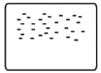
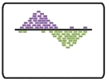

ChIP-seq analysis steps
0
1
2
√
0.0 | Acquire raw reads | fastq-dump
0.1 | Fastq quality control | fastqc
0.2 | Trimming | TrimGlore
Raw sequenced reads
√
Raw reads
√
Alignment
Aligned file
1.0 | Alignment | Bowtie2
1.1 | Convert, sort, filter | Samtools
Aligned to
Genome
Peak Calling
2.0 | Peak calling | MACS2
2.1 | ChIP quality control | ChIPQC
2.2 | Peak visualization | UCSC genome browser
2.3 | Peak annotation | ChIP-seeker
Peak list
Identified Peak
Bardet, Anaïs F., et al. Nature protocols 7.1 (2012): 45.

Slide 6
Why trim Adapter -- Adapter contamination leads to lower alignment rate
Adapters are ligated to DNA molecules during library preparation
Trim_galore:
Quality trimming
Adaptor trimming
Fastqc
In Illumina sequencing, 3’ end adapter would be sequenced
if DNA insert is shorter than number of sequencing cycles

Slide 7
Practice 4.3 (Trim_galore)
Tips: fastq-dump
trim_galore documentation
Question:
For SRR3001750, save first 100,000 read spots into a file named SRR3001750.sample.fastq, run fastqc for the output file.
Use Trim_galore to trim the output fastq file, with:
Fastqc for the output
Compare the fastqc result difference between trimmed and untrimmed file.

Slide 8
ChIP-seq analysis steps
0
1
2
√
0.0 | Acquire raw reads | fastq-dump
0.1 | Fastq quality control | fastqc
0.2 | Trimming | TrimGlore
Raw sequenced reads
√
Raw reads
√
Alignment
Aligned file
1.0 | Alignment | Bowtie2
1.1 | Convert, sort, filter | Samtools
Aligned to
Genome
Peak Calling
2.0 | Peak calling | MACS2
2.1 | ChIP quality control | ChIPQC
2.2 | Peak visualization | UCSC genome browser
2.3 | Peak annotation | ChIP-seeker
Peak list
Identified Peak
Bardet, Anaïs F., et al. Nature protocols 7.1 (2012): 45.

Slide 9
Alignment: ChIP-seq v.s. RNA-seq
Genome sequencing
ChIP-seq
ATAC-seq
Hi-C …
Transcriptome sequencing
RNA-seq
https://www.khanacademy.org/science/biology/gene-expression-central-dogma

Slide 10
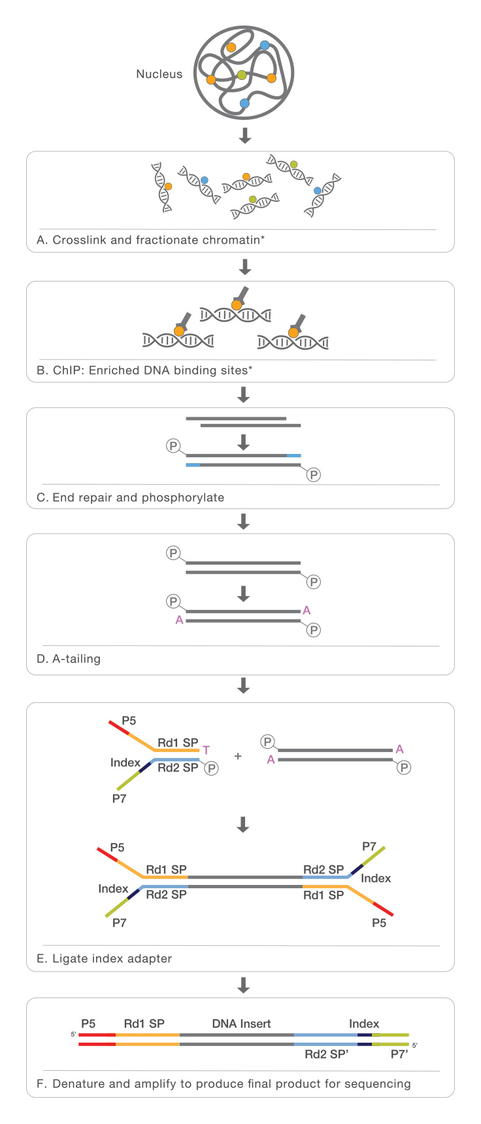
Alignment: Filter PCR duplicates
PCR amplified fragments
Reference Genome

Slide 11
Practice 4.4 (Bowtie & Samtools)
Tips:
Question:
Use bowtie2 to align the trimmed and non-trimmed fastq files from Practice 4.3 to Bowtie2Index_mm10chr2/genome_chr2 Compare the alignment rate of the two files
Sort and filter the alignment output sam files into sorted and filtered bam files

Slide 12
Contents
1. Intro to ChIP-seq
1.1 mechanism of ChIP-seq
1.2 ChIP-seq analysis intro
1.3 Fastqc
2. Alignment and Quality control
2.1 Trim_galore
2.2 Alignment and filter
3. Peak calling
3.1 Intro to peak calling algorithm
3.2 MACS2 peak calling
3.3 ChIP-QC
4. Data visualization
4.1 Data preparation for visualization
4.2 UCSC genome browser
5. Peak annotation and pathway analysis
5.1 Differential analysis with DiffBind
5.2 Peak annotation with ChIPseeker
6. Downstream analysis
6.3 Pathway analysis with ClusterProfiler

Slide 13
Homework 4.1
Tips:
Questions: (Continue from Practice 4.2)
For each file in Sample_fastq:
1.1 Use a for loop to trim the fastq files with the minimum read length after trimming 24bp.
1.2 Build a new folder named Sample_fastq_trimmed and move all the trimmed fastq files into the new folder
1.3 Run fastqc for all the trimmed files and compile the result with multiqc. Summarize in 1 sentence the difference between multiqc output of trimmed and untrimmed files
Alignment 2.1 Build bowtie2 index with genome_chr12.fa 2.2 For files in Sample_fastq_trimmed, align all to chr12 into sam files, and compile all the stderr to a file named all.align.out 2.3 Filter the all.align.out file to find out for each fastq file, what percentage of reads aligned exactly 1 time?
For all the alignment output sam files: 3.1 convert to bam, sort and filter 3.2 Summarize the sizes for all the sam files / bam files / sorted bam files / sorted and filtered bam files into a txt file named “sum_sizes.txt”

Slide 14
File formats – fastq, sam
Fastq File
Sequence identifier
Sequence
Quality score identifier (+)
Quality score
@SIM:1:FCX:1:15:6329:1045 1:N:0:2
TCGCACTCAACGCCCTGCATATGACAAGACAGAATC
+
<>;##=><9=AAAAAAAAAA9#:<#<;<<<????#=
Sam File
@HD VN:1.3 SO:coordinate @SQ SN:conticA LN:443 @SQ SN:contigB LN:1493 @SQ SN:contigC LN:328
Header
readID43GYAX15:7:1:1202:19894/1 256 contig43 613960 1 65M * 0 0 CCAGCGCGAACGAAATCCGCATGCGTCTGGTCGTTGCACGGAACGGCGGCGGTGTGATGCACGGC EDDEEDEE=EE?DE??DDDBADEBEFFFDBEFFEBCBC=?BEEEE@=:?::?7?:8-6?7?@??# AS:i:0 XS:i:0 XN:i:0 XM:i:0 XO:i:0 XG:i:0 NM:i:0 MD:Z:65 YT:Z:UU
Alignment info
Name | Sam Flag | Ref Name | Position | MAPQ quality | CIGAR string | Mate name | Mate Pos | Temp length | Read Sequence | Read Quality | Add. Info
* Columns separated by Tab (/t)
All you want to know about file formats is here: https://genome.ucsc.edu/FAQ/FAQformat.html

